Slide 1



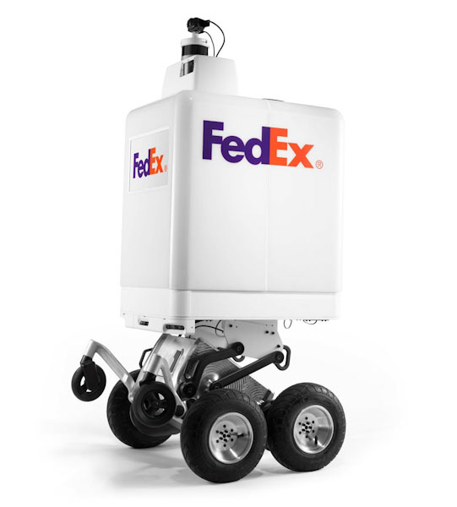


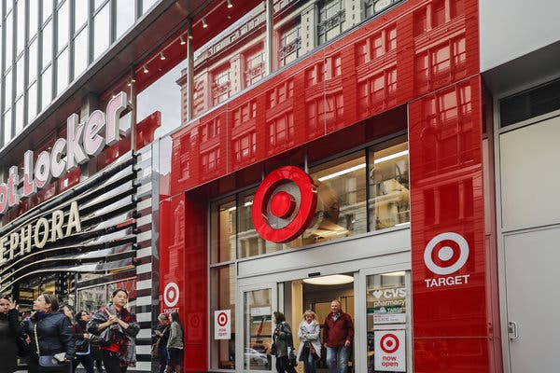
The FedEx Economy
The FedEx APIs allow the bots to make deliveries earn FedEx tokens and pay for their own maintenance.
The tokens fund startups.
The startups are an engine for growth.
This is the idea behind FedEx economy.

Slide 2
How we used the FedEx APIs
The FedEx APIs allow the bots to make deliveries and accept FedEx tokens.
The FedEx APIs allow the bots to schedule and pay for their own maintenance.
Drone
Market
FedEx APIs
Drone
Market
FedEx APIs
Order
Available FedEx meeting locations
Validate address, distance
Request maintenance
Order
Validate Job

Slide 3



Architecture
FedEx APIs
HTTP
Smart Contract
Solidity
Drone
Flask, SocketIO
Heroku
HTTP, Web Sockets
Smart Contract
Flask, SocketIO
Solidity
Etherium
Heroku
HTTP, Web Sockets
Website
Flask, SocketIO, HTML5
Heroku

Slide 4

Marketplace Demo Video

Slide 5





The FedEx Economy
Summary
Team and Roles
Content Library
The Problem: The FedEx APIs can turn the FedEx SameDay bots into a new way to fund small businesses. We can build a token economy where startups thrive.
Data Scientist Preethi Prabhakar pprabhakar27@dxc.com (Applied AI CoE Intern & Drexel Student)
GitHub Repo: Click Here
Data Scientist Daniela Raygadas Dominguez draygadasdom@dxc.com (Applied AI CoE Intern & Drexel Student)
Video: Click Here
The Hack: The FedEx APIs allow the bots to make deliveries and accept FedEx tokens. The tokens fund startups. The startups are an engine for growth.
Data Scientist Shivani Aggarwal saggarwal56@dxc.com (Applied AI CoE Intern & Drexel Student)
Presentation: Click Here
Director Jerry Overton joverton@dxc.com (Applied AI CoE Director)
FedEx APIs used: Click Here
Potential Impact: The bots become self-owning infrastructure that powers a small business ecosystem. The ecosystem generates block chain data that allow for new FedEx APIs.
Designer Hitesh Kumar hkumar34@dxc.com (Applied AI CoE Design Lead)
App Demo: Embedded in Presentation

